Slide 1
SELENIUM
&
TESTOPS

Slide 2
Agenda
Agenda:
Introduction to Selenium
Setup Selenium WebDriver in Eclipse
Install TestNG in Eclipse
Create simple script
Use Jenkins to schedule tests
Testops

Slide 3
Introduction to Selenium
Selenium is a suite of tools to automate web browsers. It includes 4 tools: Selenium IDE, Selenium WebDriver (Selenium 2), Selenium RC (Selenium 1) and Selenium Grid.
Selenium supports many browsers (Firefox, Chrome, Internet Explorer...), operating systems (Microsoft Windows, Linux...), Frameworks (TestNG, Junit...) and programming languages (Java, Python...).
It is also a popular open-source software with a large community of users.

Slide 4
Introduction to Selenium
In the context of this introduction, we shall use Selenium WebDriver and Selenium IDE to demonstrate how to automate tests. So what exactly are Selenium WebDriver and Selenium IDE? And what are the differences between them?
    Selenium IDE is a Firefox add-on which supports capture and playback tests. Its main use is to create quick and simple scripts. To record script using Selenium IDE, first install Selenium IDE addon then open and click on Record button to start recording your steps. You can also export this script to a programming language like Java, Python... The Selenium IDE's GUI looks like below:

Slide 5
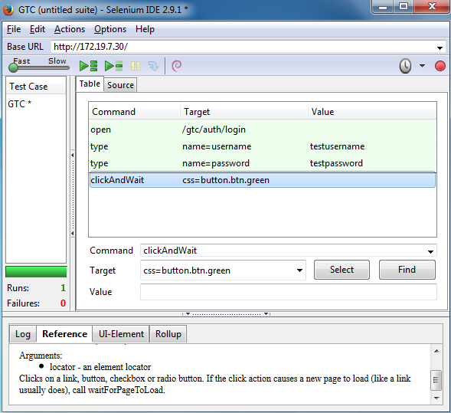
Introduction to Selenium

Slide 6
Introduction to Selenium
    Selenium WebDriver is a Selenium tool which supports many browsers like Firefox, Chrome, IE... and scripting language instead of just record and playback like Selenium IDE. Using Selenium WebDriver, we can maintenance test cases better than using Selenium IDE. For example: Some web elements's names, ids are changed and we need to update test cases using corresponding names and ids of these elements. This update process takes a lot of time in case of using Selenium IDE since Selenium IDE does not support page object or object repository => We have to change ids/names to new ones for each related test case. Also Selenium IDE does not support iteration and conditional statements natively.
    To setup Selenium WebDriver in Eclipse IDE, follow below steps:

Slide 7
Setup Selenium WebDriver in Eclipse
Download and install Eclipse IDE for Java EE Developers 64 bit
Download and install Java JDK 8 Windows 64 bit. Setup JAVA_HOME and Path.
Download Selenium Client for Java.
To add Selenium Client to a Java Project:
+ Create a new Java Project
+ Right click on the Java Project and select Properties -> Java Build Path > Add External JARs > Browse to Selenium Client folder and select all jar files > Click on Ok to save.

Slide 8
Setup TestNG in Eclipse
Why use TestNG?
    It supports flexible annotations.
    It automatically generates test report.
    It supports customization the order of execution of tests and more...
Setup TestNG
    Open Eclipse > Help > Eclipse Marketplace > Search for TestNG then install it.

Slide 9
CREATE SIMPLE TEST SCRIPT

Slide 10
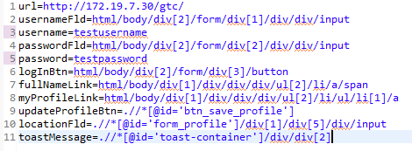
Create simple test script
Step 1: First create a new Java Project "GTC"
Step 2: Create a config.properties file to stores xpath which is used to locate a web element (Note: There are many other ways to locate a web element like using name, id...)

Slide 11
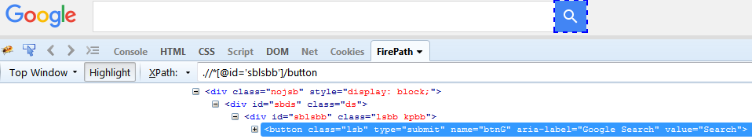
Create simple test script
Note: In Firefox, we can install Firebug add-on and its extension FirePath (which inspects and generates Xpath); right click on a web element then select Inspect in FirePath to get web element's name, class, Xpath.
In Chrome, we can right click on an element then select Inspect to view element's name, class...

Slide 12
Create simple test script
Step 3: Create a "LogInClass" class which is used to login to GTC.
    Right click "GTC" then select New > Other > TestNG > TestNG class then click on Next.
    Input /GTC/src into Source folder, input com.pkg.test into Package name, input LogInClass into Class name, input testng.xml into XML suite file
    LogInClass.java 's code looks like below:

Slide 13
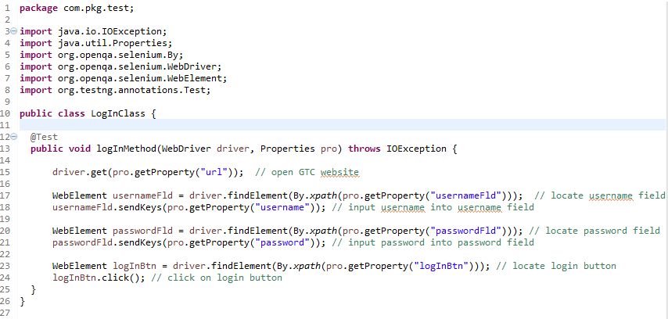
Create simple test script

Slide 14
Create simple test script
Step 4: Create a "UpdateProfileClass" class which is used to edit profile.
    Right click "GTC" then select New > Other > TestNG > TestNG class then click on Next.
    Input /GTC/src into Source folder, input com.pkg.test into Package name, input UpDateProfileClass into Class name.
    UpDateProfileClass.java 's code looks like below:

Slide 15
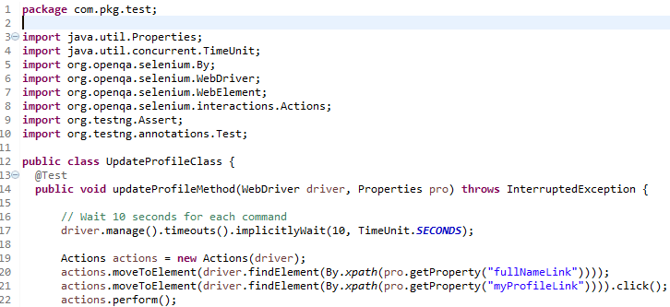
Create simple test script

Slide 16
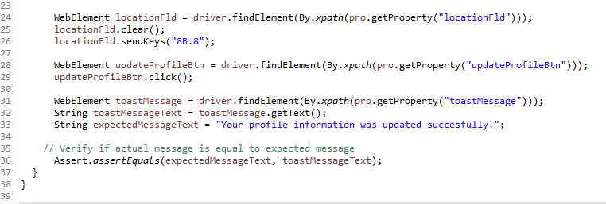
Create simple test script

Slide 17
Create simple test script
Step 5: Create a "MainClass" class which is used to instantiate "LogInClass" and "UpdateProfileClass"
    Right click "GTC" then select New > Other > TestNG > TestNG class then click on Next.
    Input /GTC/src into Source folder, input com.pkg.main into Package name, input MainClass into Class name.
    MainClass.java 's code looks like below. Select this class then run it to execute the script.

Slide 18
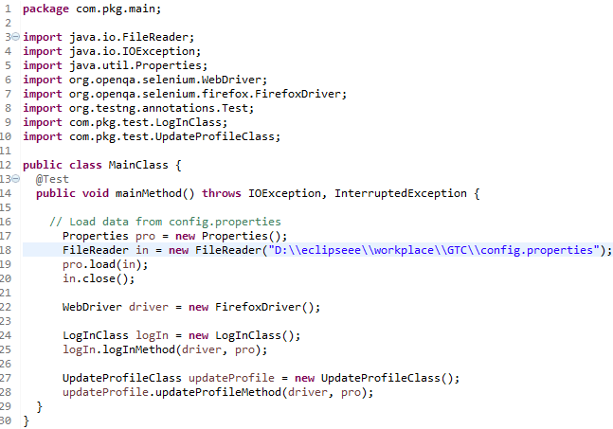
Create simple test script

Slide 19
USE JENKINS TO SCHEDULE TESTS

Slide 20
Use Jenkins to schedule tests
What is Jenkins? - Jenkins is a cross-platform, open source continuous integration tool written in Java. We can use Jenkins to trigger build by source changes or at a specific time.
Use Eclipse to compile
code from src folder to
bin folder
Use Jenkins to execute
Windows Batch Command
at a specific time
Windows Batch Command
runs tests based
on testng.xml and
generate TestNG report

Slide 21
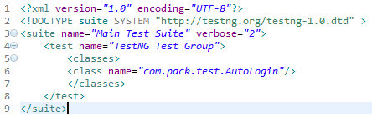
Use Jenkins to schedule tests
Precondition: Use existing "GTC" Java Project, create "lib" folder inside "GTC"Java Project then add Selenium libs and TestNG libs into "lib" folder. Ensure "bin" folder contains Java class files of "GTC" Java Project. Also you need to create a testng.xml file to invoke TestNG in Jenkins.
    testng.xml file looks like below (verbose – the verbosity level):

Slide 22
Use Jenkins to schedule tests
Step 1: Download Java Web Archive file (.war)
Step 2: Start Jenkins by using below command
    java -jar jenkins.war –httpPort=9090
Step 3: Access Jenkins by using web browser and go to url http://localhost:9090/
Step 4: Create a new item > Input "GTC project" into Item name and select FreeStyle Project > Click on Ok button. Under Build section, click on Add build step > input below command:
java -cp "D:\eclipseee\workplace\GTC\lib\*;D:\eclipseee\workplace\GTC\bin" org.testng.TestNG "D:\eclipseee\workplace\GTC\testng.xml"

Slide 23
Use Jenkins to schedule tests
Step 5: Setup test schedule. Under Build Triggers, check on Build periodically checkbox. You can setup time schedule follows the similar syntax of cron
  MINUTE HOUR DOM MONTH DOW
  These fields are separated by TAB or whitespace
  MINUTE Minutes within the hour (0-59)
  HOUR The hour of the day(0-23)
  DOM The day of the month (1-31)
  MONTH The month (1-12)
  DOW The day of the week (0-7) where 0, 7 are Sunday

Slide 24
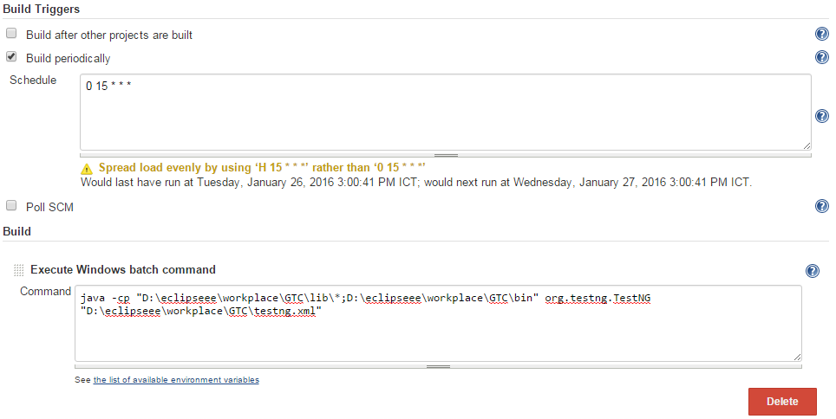
Use Jenkins to schedule tests
  For example:

Slide 25
Use Jenkins to schedule tests
Note:
  You can also choose to build the project immediately by using Build Now option.
  To check for build info: From Dashboard, click on the project > Build history. You can see if the build is successful or failed here.
  To check for build log: using Console Log option in Project page.

Slide 26
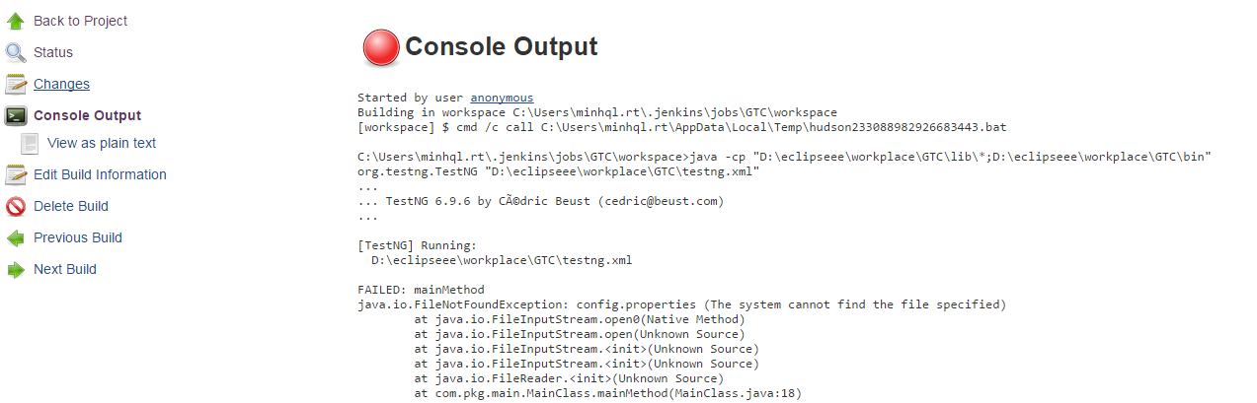
Use Jenkins to schedule tests

Slide 27
CONTINUOUS INTEGRATION

Slide 28
Us
Note:
  You .

